Slide 1

Real-time Emotion Recognition: The Power of Video Analysis
Ramapriya Ranganath
Silas Morris

Slide 2
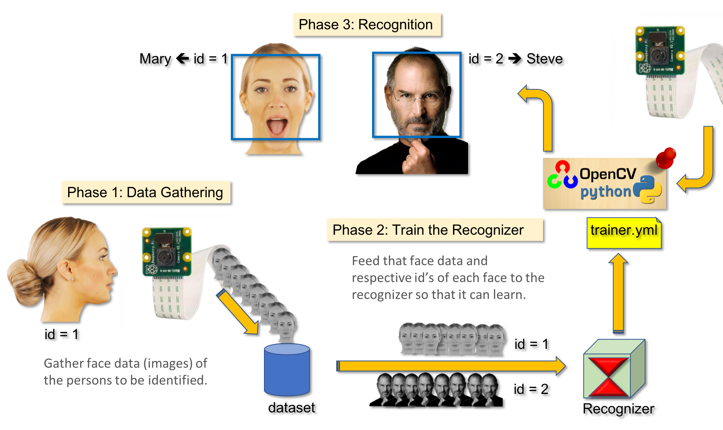
Introduction
Real-time emotional analysis with OpenCV is a new and exciting field
It uses advanced computer vision techniques to analyze facial expressions and body language in real-time
This technology has applications in healthcare, marketing, and crime prevention
It can help improve communication, diagnose mental health conditions, and provide valuable insights into an individual's emotional state

Slide 3

STATS
In this project, we have selected patients with Central Nervous System (CNS) Breakdown as our target audience and helped them to alter their dosage on time
Affects 3 Million patients
55.8% Total spending is on Emergency Room and Inpatient care
63% of patients had a negative impact on their emotional well-being
45% had a negative impact on their ability to work.
20% had liver failure

Slide 4
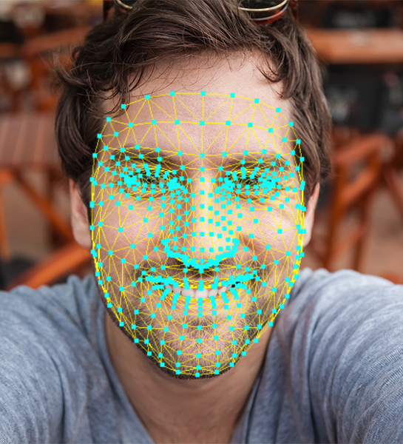
The Challenges of Real-Time Emotion Recognition
Real-time emotion recognition in video presents challenges
High-quality video data is needed for accurate emotion recognition
Low-resolution or noisy videos can lead to inaccurate results
Algorithms must be robust and adaptable
Emotions can be expressed in many different ways across different cultures, languages, and contexts. Here we have used FER 2013 from Kaggle
Emotions can change rapidly, so algorithms must be able to adapt to changes in emotional expression over time.

Slide 5
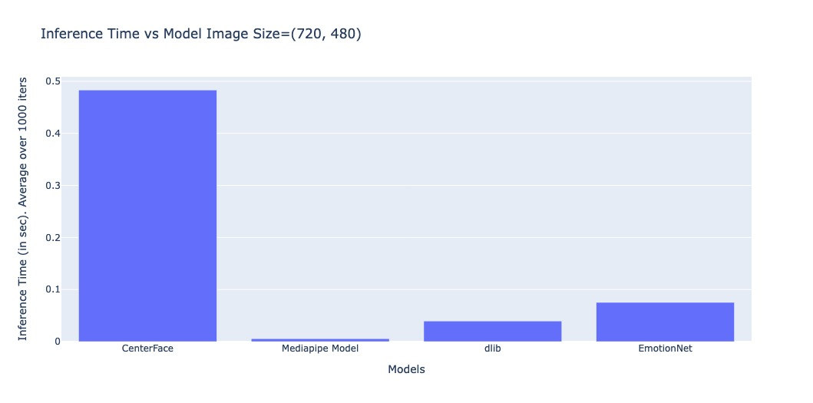
Graphs
We are showing that our model can be used in real-time applications. Pipeline: face extraction from an image + emotion extraction. Using two-step CNN is somewhat costly. We have to ensure that it won't consume too much time Exp: We have compared different models (3), for the face extraction.
1) CenterFace: its pretty accurate for even tiny faces and its trained on WiderFace dataset. This works for most of the cases.
2) mediapipe model is used to extract faces from selfie images. The face has to be near to the cam to extract faces. Otherwise, the model might fail
3) classical technique HOG + linear SVM. This is pretty fast and may work for challenging cases.
For our use case, all these models gave good results. Inference time is less for all the three models. <0.5 sec for face extraction and <0.5 sec for CenterNet. Our whole system works in real-time.
One can pick the model among these three based on their preferences:
Accurate face detection vs very fast detection
Final layer of MobileNetV2 is modified from 1000 classes to 7 class

Slide 6
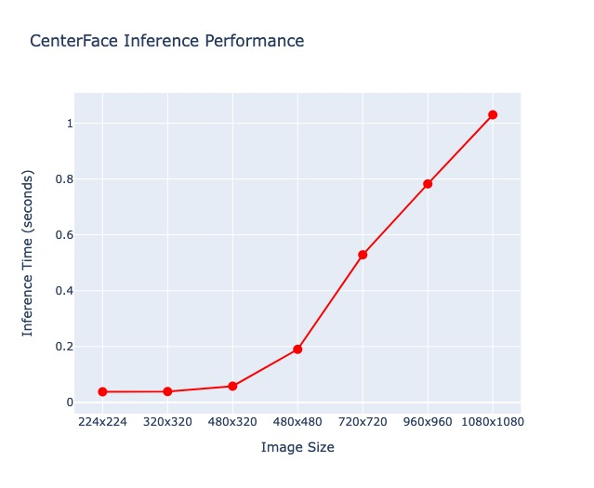
Graphs
Here we have resolution on x-axis and time in seconds on y-axis
As we increase resolution the time increases.
224x224 is the preferred resolution here as it is takes less time when compared to higher resolution ones

Slide 7
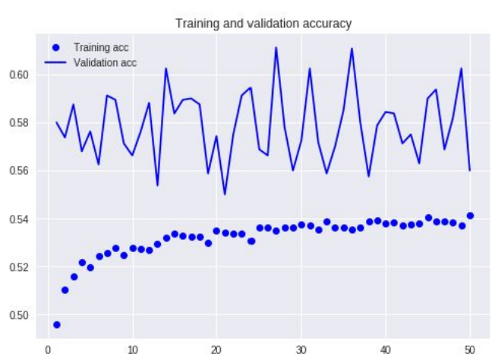
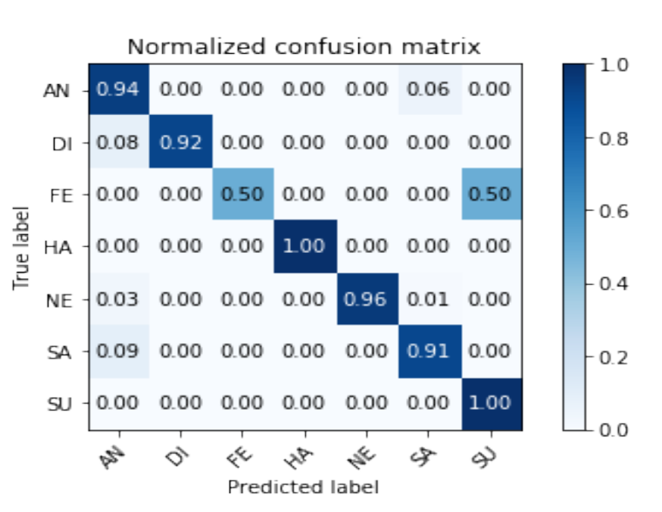
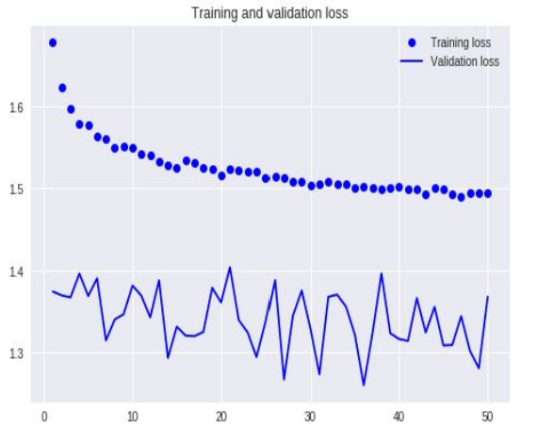
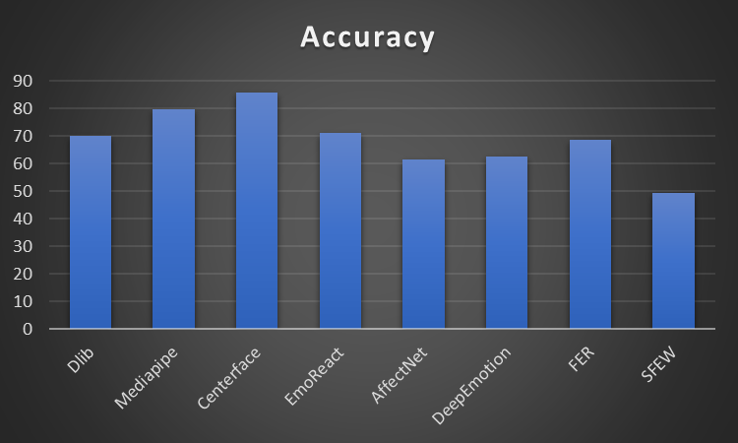
Accuracy
50-55%

Slide 8
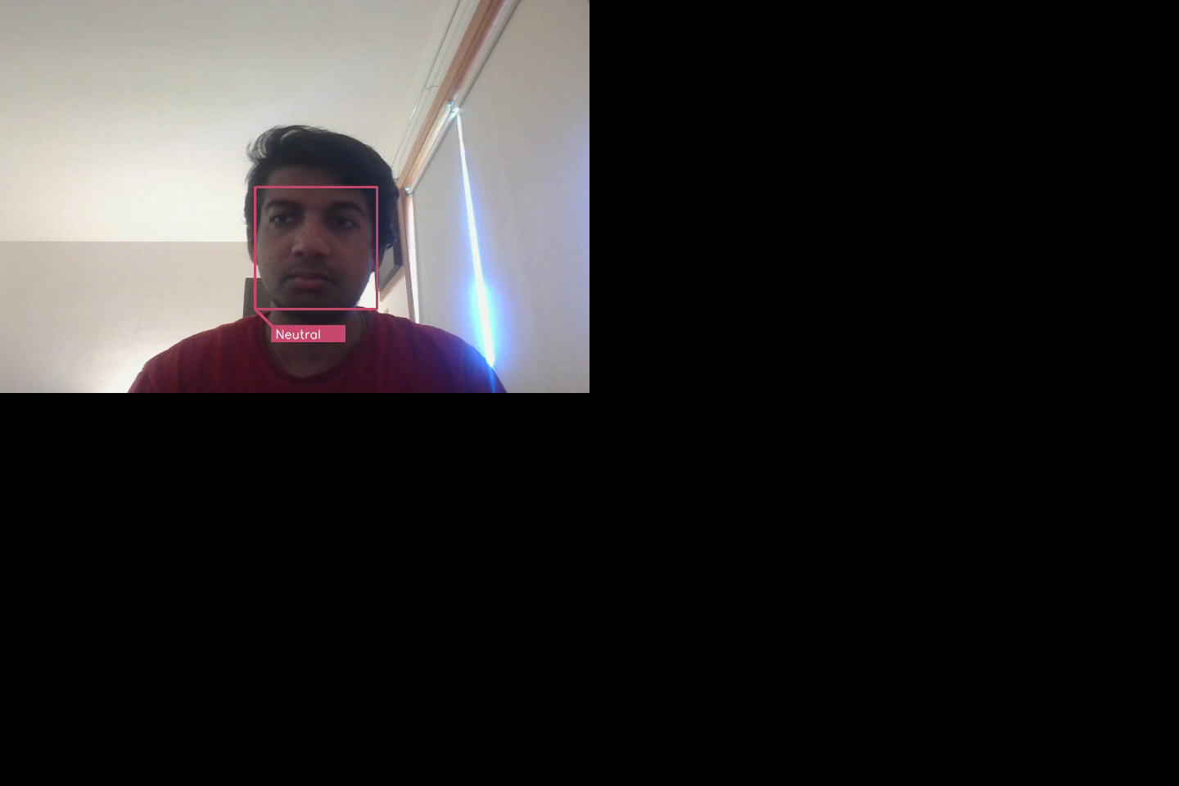
Demo

Slide 9
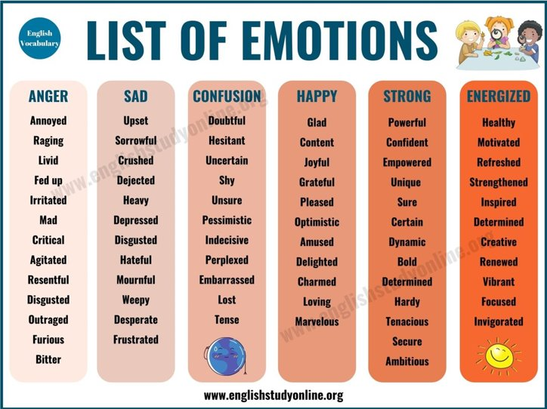

Facial Expression Recognition
Facial expression recognition is a common application of real-time emotional analysis using OpenCV
It involves analyzing facial features to identify emotions such as happiness, sadness, anger, and surprise
OpenCV uses Haar cascades and machine learning algorithms such as SVMs and CNNs for facial expression recognition
These algorithms are trained on large datasets of labeled images to learn how to accurately recognize different emotions.

Slide 10
Training
We downloaded the FER-2013 emotion dataset from Kaggle
https://www.kaggle.com/datasets/msambare/fer2013
This data set consisted of 28,709 individual 48x48 image of labeled emotions.
We used these to train a CNN model to detect emotions.
Preprocess the images, which can involve tasks such as resizing, cropping, and normalizing the images to ensure they are consistent.
After preprocessing, the images are fed into the CNN for training. The CNN will adjust the weights of its layers through backpropagation to improve its accuracy in recognizing faces.
Training a CNN for facial recognition can be a time-consuming process that requires a lot of computing power.
Once the model is trained, it can be used for facial recognition tasks such as identifying individuals in photos or videos. However, it's important to note that even the best facial recognition models are not perfect and can still make errors, particularly when dealing with images that are low-quality or have poor lighting conditions.

Slide 11
Predicting
Face detection: This will enable you to identify the faces that need to be analyzed for emotions.
Image pre-processing: Before feeding the face image to the emotion detection model, we pre-process the image by cropping, resizing, and converting it to grayscale.
Emotion mapping: Once you have obtained the emotion predictions from the model, we map them to a set of emotional states such as happy, sad, angry, etc. This will enable you to display the detected emotions in a more human-readable format.
Real-time display: Finally, we display the real-time emotion analysis results in a graphical user interface (GUI)

Slide 12
Website
Our work can be seen in detail on:
https://rama25.github.io/-Emotional-Analysis-Using-CNN/
We were able to embed OpenCV and TensorFlow into our JavaScript to provide a live demo to play with!

Slide 13
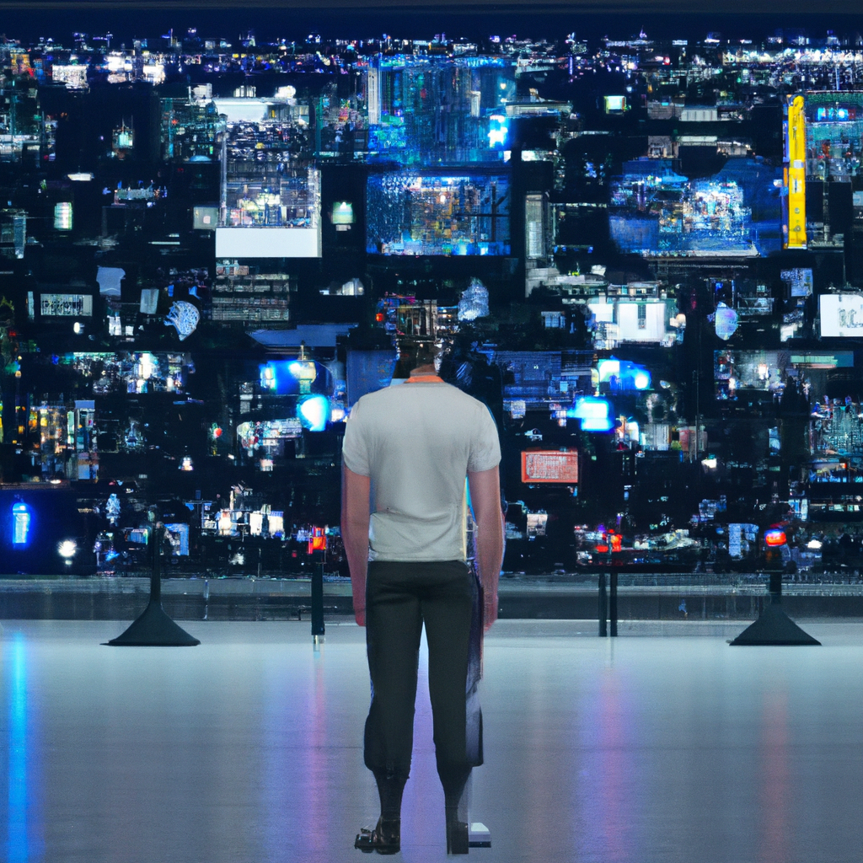
Conclusion
Real-time emotional analysis using OpenCV can transform the way we understand human emotions
It provides valuable insights into the emotional state of individuals
It can help improve communication, diagnose mental health conditions, and even prevent crime
Challenges include ensuring accuracy and addressing privacy concerns
The potential benefits of this technology are immense, and the field is evolving to provide more innovative applications and solutions.

Slide 14
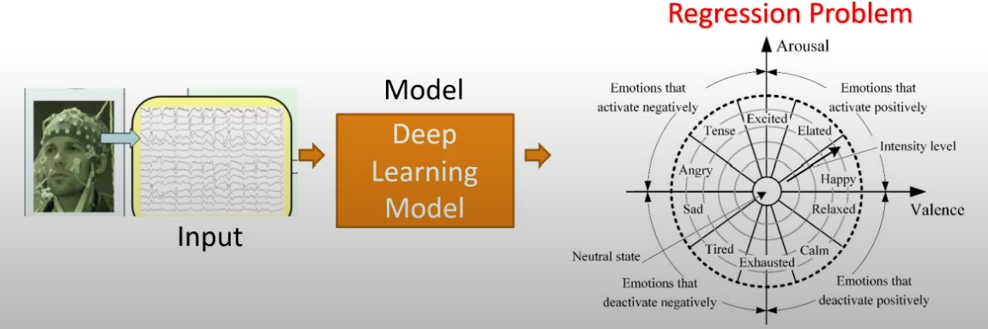
Future Work
Classification Problem -> Regression Problem using Body Sensors
Increase accuracy

Slide 15
References
[1] Cleynen I., Gonzalez J., Figueroa C., Franke A., McGovern D., Bortlik M., et al. (2013) Genetic factors conferring an increased susceptibility to develop Crohn’s disease also influence disease phenotype: results from the IBDCHIP European project. Gut 62: 1556–1565.
[2] E. Horvitz. Principles of mixed-initiative user interfaces. In Proceedings of CHI '99, ACM SIG CHI Conference on Human Factors in Computing Sys-tems, Pittsburgh, PA, ACM Press., pages 159-166,May 1999.
[3] Goodfellow, Ian J "Challenges in representation learning: A report on three machine learning contests" International conference on Neural Information Processing Berlin 2013
[4] Accenture. (2021). The future of work: Productive anywhere. Retrieved in February 2023 from: https://www.accenture.com/_acnmedia/PDF-155/Accenture-Future-Of-Work-Global-Report.pdf#zoom=40
[5]Fragopanagos, N., & Taylor, J. G. (2005). Emotion recognition in human–computer interaction. Neural Networks, 18(4), 389–405. https://doi.org/10.1016/j.neunet.2005.03.006
[6]Hossain, M. S., & Muhammad, G. (2017). An emotion recognition system for mobile applications. IEEE Access (5), 2281-2287. https://ieeexplore.ieee.org/document/7862118
[7]Podoletz, L. (2022). We have to talk about emotional AI and crime. AI & Society. https://doi.org/10.1007/s00146-022-01435-w
[8]Suk, M., & Prabhakaran, B. (2014). Real-Time Mobile Facial Expression Recognition System -- A Case Study. 2014 IEEE Conference on Computer Vision and Pattern Recognition Workshops. https://doi:10.1109/cvprw.2014.25

